Slide 1
Progress report
Dispinlary
Team1
Group 6

Slide 2
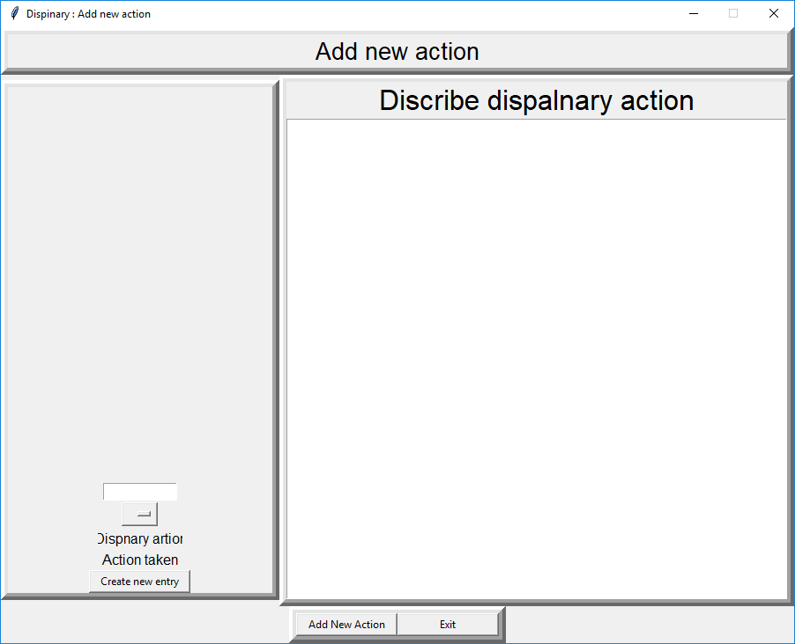
Progress from phase 1
Able to create new records for disciplinary action
Read records from disciplinary list (for easier use)

Slide 3
Current Functionality
Emplyee ID textbox input

Slide 4
Current Functionality
Disciplinary name drop-down box

Slide 5
Current Functionality
(will eventually) show the description about the selected disciplinary action

Slide 6
Current Functionality
Description about why the action is taking place and any additional comments about the action

Slide 7
Current Functionality
Creates a new entry in the databases using the data given – does validation to ensure the inputs are valid

Slide 8
Current Functionality
Opens a new for adding a completely new disciplinary action.

Slide 9
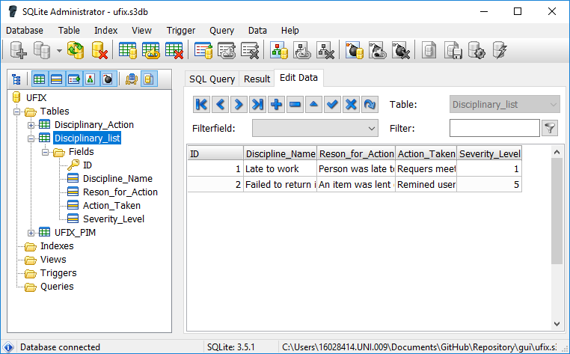
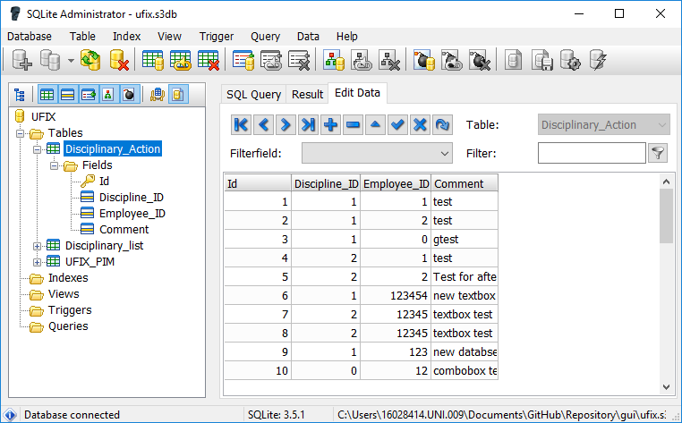
Database
*current data is for testing purposes only

Slide 10
Python Related Problems
Had to spend time learning how to use python, PyCharm and the Tkinter GUI API. This time could have been spent developing witch slowed down the project.
Had problems laying-out Tkinter widgets correctly.
Had problems recently with Combo-box events not triggering problems.

Slide 11
Phase 1 Reflection
We didn’t fully understand the principles of Scrum and the overall objectives of the program: we have begun to make better use of tools (such as Trello and Slack) in order to help us follow Scrum.
We have better recently at splitting up tasks between team-members based on their roles for each sprint
We had issues with the GitHub – not all team members had access. We overcame this by focusing more on the design in the first few weeks, and have since made extensive use of GitHub.

Slide 12
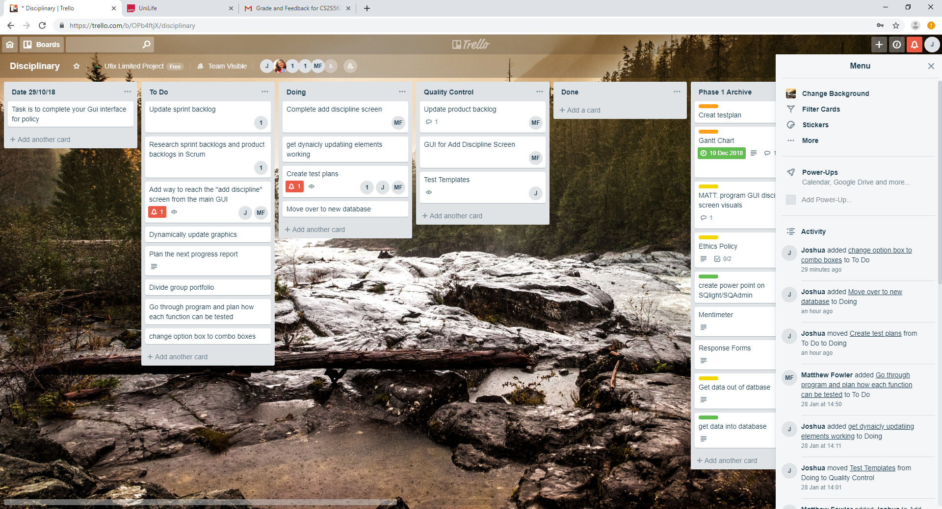
Phase 1 Reflection
Since Christmas, we have made better use of tools to achieve Scrum, such as Trello and Slack.

Slide 13
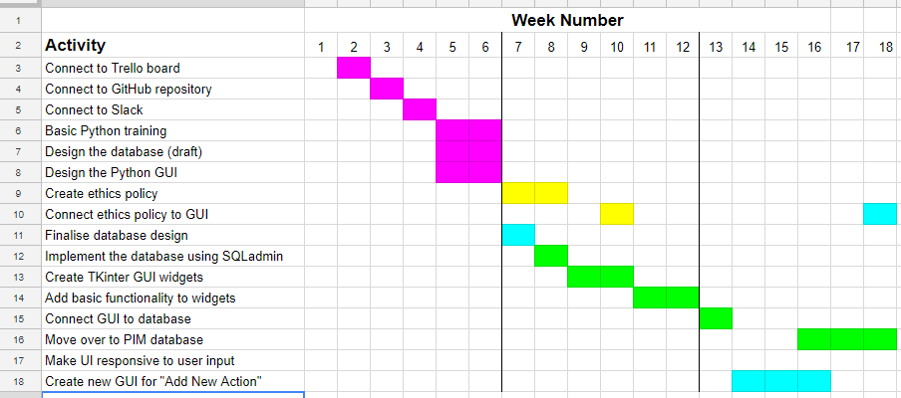
Gantt Chart

Slide 14
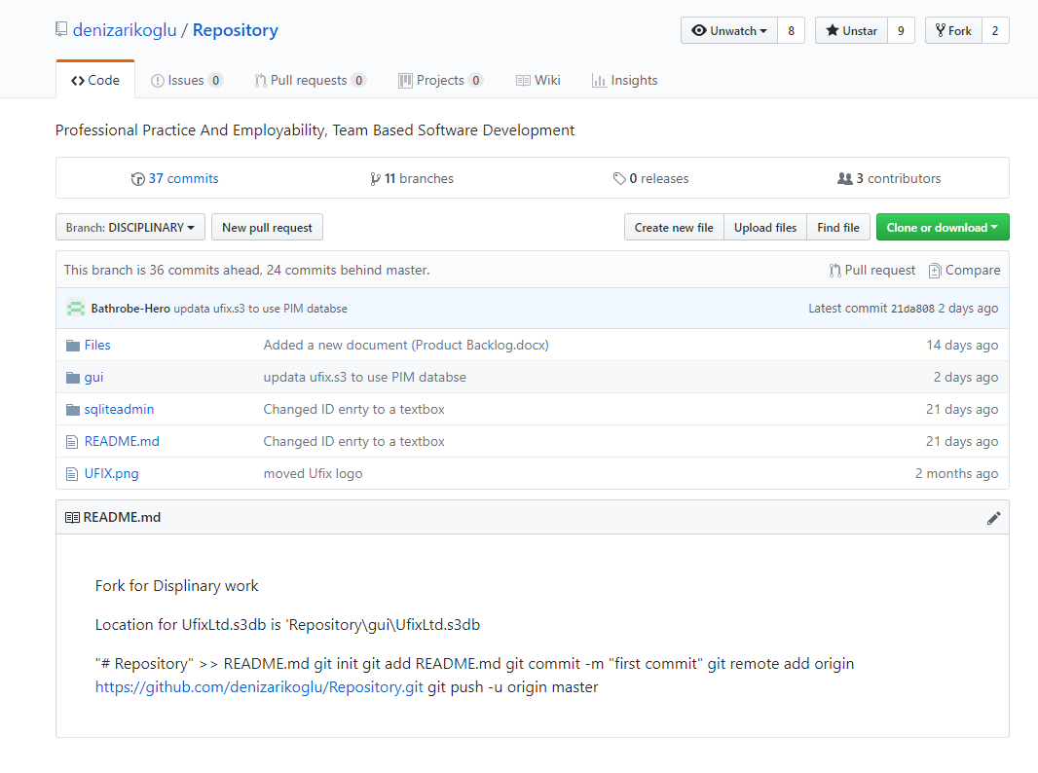
Phase 1 Reflection
We have also extensively used GitHub to keep track of individual’s contributions to the project, and to keep backups of the code at different points in development.

Slide 15
Phase 2 Objectives
Link together employee IDs with the disciplinary actions currently stored
Complete the second “add new disciplinary action” screen – in progress
Change validation of user ID from: checking if anything is inputted in the textbox, to whether the given ID exists in the database.
Add a login system – this system has not yet been designed
Unit testing (see next slide)

Slide 16
Testing
Unit testing shall be used to test individual parts of the code
We will use the “unittest” module – we have experienced problems installing this module in the labs (specifically installing the correct PIP version).
Test plans will be created to test program functionality from the user’s perspective. It will require completed code however, meaning that we have not started running the tests yet.

Slide 17
Contact Details
Matthew Fowler: 17025958@students.southwales.ac.uk
Joshua Childs: 16028414@students.southwales.ac.uk
Aleksander …
Any Questions?

